Slide 1

Revolutionizing Job Applications: The AI Resume Generator
Imagine a world where creating a compelling resume is effortless. This presentation explores the transformative power of AI in resume generation and its potential to revolutionize the job application process.

Slide 2
The Current Resume Landscape: Challenges and Limitations
Time-consuming
Lack of personalization
Difficulty tailoring
Creating a standout resume requires hours of effort, formatting, and revisions.
Generic templates often fail to highlight individual skills and experiences.
Adapting resumes for specific roles can be challenging and time-consuming.

Slide 3
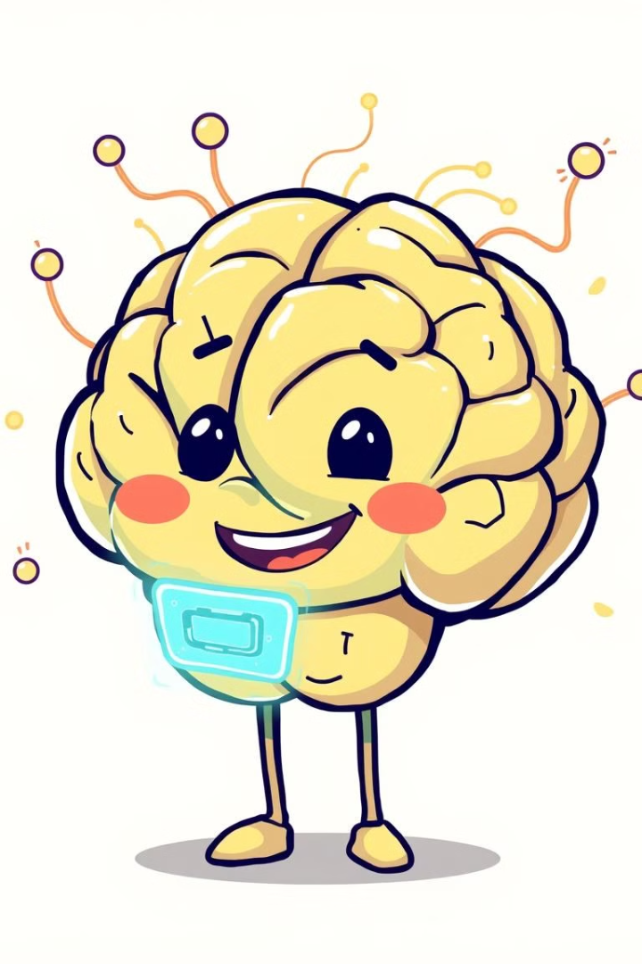
How Generative AI Transforms Resume Creation
1
Automates the process of creating a resume from scratch.
2
Generates personalized content based on individual skills and experiences.
3
Tailors resumes to specific job descriptions and industry keywords.
4
Provides real-time feedback on content and formatting.

Slide 4
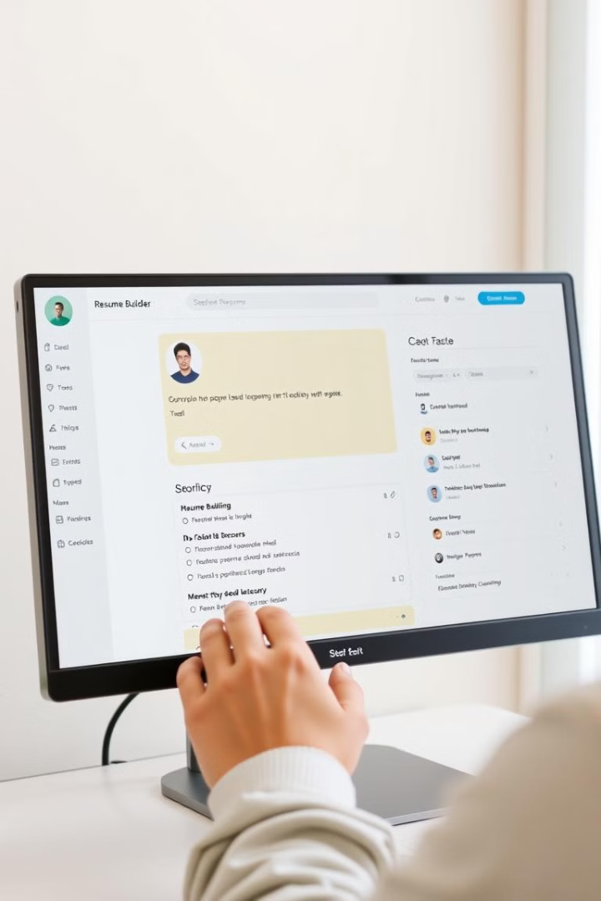




Key Features of an AI-Powered Resume Tool
Smart Content Generation
Job Description Matching
Professional Templates
AI provides a range of visually appealing and industry-standard resume templates.
AI analyzes user input and generates compelling resume content, highlighting relevant skills and experiences.
AI identifies keywords and phrases in job descriptions and automatically tailors resumes for optimal matching.
Real-Time Feedback
AI offers instant feedback on content, formatting, and grammar, ensuring a polished final product.

Slide 5

Technology Behind Smart Resume Generation
Deep Learning (DL): AI models are trained to recognize complex patterns and relationships in data, leading to more sophisticated outputs.
Machine Learning (ML): AI learns from vast datasets of resumes and job postings to generate personalized and effective content.
Natural Language Processing (NLP): AI understands and interprets user input and job descriptions.

Slide 6





Personalization and Optimization Strategies
User profiles: AI collects information on skills, experiences, and career aspirations.
Job targeting: AI identifies relevant job descriptions and adapts resumes accordingly.
Content optimization: AI refines resume content to match industry standards and keywords.
Feedback and iteration: AI provides suggestions for improvement and allows users to refine their resumes.

Slide 7

Real-World Impact: Success Stories and User Benefits
100K+
90%
Resumes Generated
Improved Job Application Outcomes
AI-powered resume tools have helped countless users craft compelling resumes.
Users have reported increased job interview rates and successful applications.
80%
Time Savings
AI tools have significantly reduced the time and effort required to create a resume.

Slide 8

Future of AI in Career Development and Job Matching
AI's role in career development is evolving rapidly. Expect personalized career guidance, AI-powered skills assessments, and seamless job matching platforms. This AI-driven transformation promises to reshape the future of work, empowering individuals to achieve their full potential.

